Slide 1

Next Gen Blackholing to Counter DDoS SAFNOG-5, South Africa Christoph Dietzel §* †, Matthias Wichtlhuber*, Georgios Smaragdakis §, Anja Feldmann † §TU Berlin, *DE-CIX, †MPI
Notes:
Welcome and thank you for the introduction
This is joint work with my colleagues Chris, George, and Anja from TU Berlin, TU Berlin and DE-CIX
Let me start with a bit of motivation on why we need a better blackholing mechanism

Slide 2
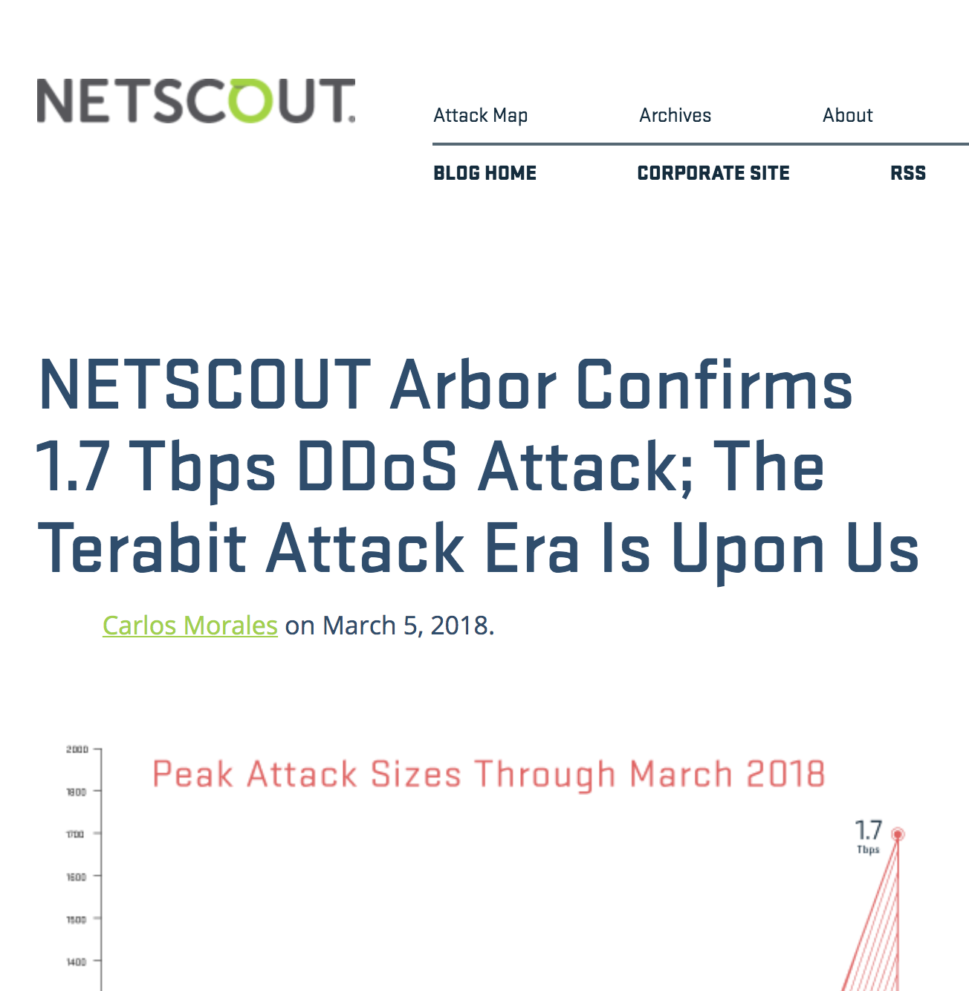
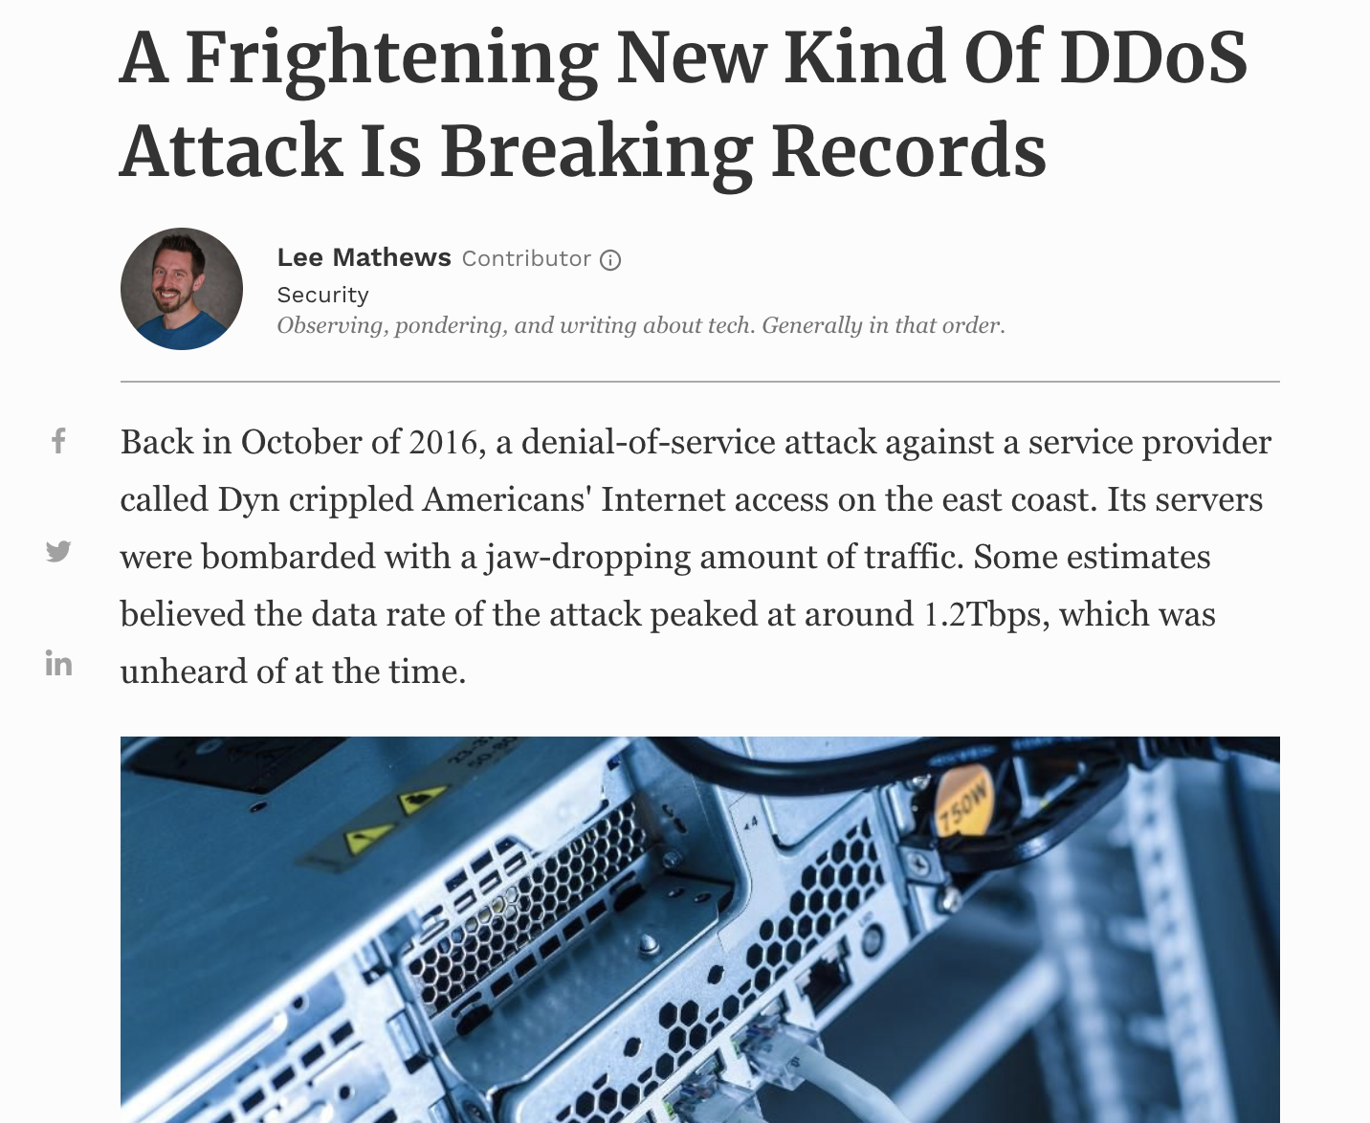
Volumetric DDoS Attacks
? Tbps
1.7 Tbps
1 Tbps
200 Gbps
‘15
‘16
‘18
‘19
Notes:
Many of you face DDoS attacks
Volumentric DDoS attacks
DDoS attacks depleting network resources through a high volume of traffic
Steep increase in peak attack volume sinc 2015
In 2016, a 1.2 Tbps attack crippled the Internet in the US
Last year Netscout reported a 1.7 Tbps attack
What will come next and how can networks be defended from an operator‘s perspective?
Not just big attacks but also a high volume of smaller ones.
Will this become better with the Internet of Things? Probably not …

Slide 3
ISP DDoS Defense Toolbox
ACL
TSS
(Traffic Scrubbing Services)
Flowspec
Carefree service
Vendor- specific
Filters at arbitrary granularity
Redirects traffic to scrubbing centers
Configures rules at neighbor network
Filters at arbitrary granularity
RTBH
Configures rules at neighbor network
Filters at IP granularity
Per device config
On-demand vs. always on
Cooperation required
Cooperation required
Notes:
This is not a new topic .
Let‘s investigate the current ISP DDoS toolbox

Slide 4
DDoS Defense at IXPs
Combine good properties of existing solutions
Eradicate current shortcomings
+ IXPs offer services to hundreds of Ases
+ IXPs have multiple Tbps capacity
+ Trusted part of the Internet community
Notes:
How to do it at IXPs? We know the current solutions, do our idea is to combine the good properties while eradicating their shortcomings
In the following I’m going to distill a good solution for Internet Exchanges
By doing this sort of DDoS defense at the IXP, we immediately have the following benefits.
IXPs offer services to hundreds of Ases
IXPs have multiple Tbps to absorb attacks
IXPs are a trusted part of the Internet community

Slide 5
Blackholing at IXPs
②
①
Notes:
Recap how does blackholing work today
Probably most of you know this already, but we explain it in order to explain ist shortcomings lateron
Left control plan, right data plane, we have three Ases in this scenario, where one AS hosts a service
On the left, the control plane view is shown: AS1 peers with AS2 and AS3 via multilateral peering at route servers by announcing ist prefix to the route server, which has forwarded the route to AS2 and AS3
On the right, we see a typical data plane view of an attack scenario with an NTP reflection attack flowing from ASes 2 and 3 to AS1, which leaves customers wanting to reach the service under attack in AS1 with an unsatisfying Quality of Service

Slide 6
Blackholing at IXPs
①
②
③
Notes:
After having analyzed the attack, AS1 can protect the service under attack as well as its link to the IXP using blackholing
(1) Therefore AS1 announces the route with a special blackholing signal, for instance the standradized blackholing community
(2) The routeserver forwards the announcement to AS2 and AS3, but only AS2 accepts the blackholing route whild AS3 drops it
(3) On the data plane this lead to a blocking of the traffic sent via AS2, while AS3 contniues ot forward traffic to AS1
The service may continue to suffer from bad reacability.

Slide 7
Blackholing – Limitations
Blocks unwanted and wanted traffic
Behavior is hard to predict
→ No effect on a subset of peerings
③
Notes:
Summing up, blackholing has some serious limitations

Slide 8
Blackholing – Limitations
Relative traffic of 40GE IXP port
Mostly web traffic (80, 443, …)
Attack 70% memcached traffic
Still significant share of web traffic
→ Collateral damage!
Notes:
Regarding the blocking of wanted and unwanted traffic, we mwaured several DDoS attacks
On exmaple is shown here
In this case, balackholing also drop a share of 30% legitimate web traffic
That means blackholing causes a large amount of collateral damage

Slide 9
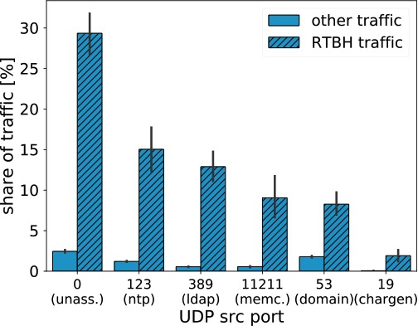
Blackholing – Limitations
All or nothing approach
Prefix granularity
Per peer selection at IXPs
Blackholing traffic:
99.94% UDP
Expected L4 ports (NTP, LDAP, …)
→ More granularity needed!
Notes:
Could we make use of a higher filtering granularity than prefix based granularity?
Hypothesis: a few rules for blocking traffic and a source peer selection could help a lot to block DDoS
When measuring RTBH traffic, we can see 99.4% UDP and the expected Layer 4 ports, e.g., LDAP, NTP, etc.
Only six blocking rules are enough to filter 80% of the DDoS traffic
Comparison not entirely fair, it works better for anything less sepcific than /24, but /32s make up for 99.99% of blackholing traffic

Slide 10
Blackholing – Limitations
How “ineffective“ can it be?
NTP DDoS attack
AS at IXP via ML peering
Attacks for 10 min to /32
Drop all traffic to /32
Traffic: 800 to 600 Mbps
Peers: 38 to 26
→ Signaling too complex!
Notes:
Second we measured how ineffective blackholing at IXPs can be
We attacked ourselves for ten minutes and blackholed the respective /32 after ~400 seconds
Results: …

Slide 11
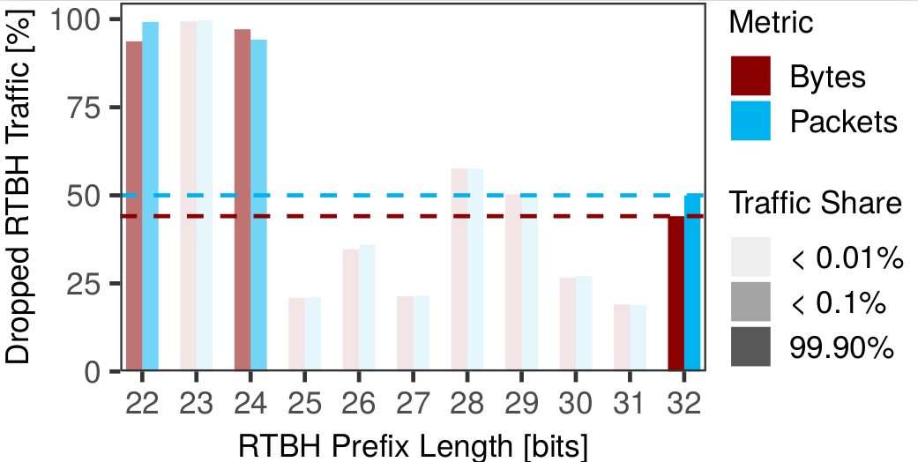
Blackholing – Limitations
Blackholing works for anything > /24 …
… but /32s make up for 99.99% of blackholing traffic.
→ Signaling too complex!
Notes:
Afterwards, we correlated the blackholing prefixes with the dataplane and compared how much traffic that should be dropped is dropped in reality.
We found a high dependency on the size of the prefix
Less specific than /24, nearly all the traffic that should be droppes is dropped
For /32s, only half of the traffic that should be dropped is dropped
BUT: 99.9% of the blackholing traffic is destined to a /32 blackholing route

Slide 12
Advanced Blackholing Requirements
Granularity
Fine-grained filtering (src/dst header fields)
Signaling complexity
Easy to use, short setup time
Cooperation
Lower levels of cooperation among the involved parties
Telemetry
Feedback on the state of the attack at any time
Scalability
Scale in terms of performance, filters, reaction time, config complexity
Cost
Meeting all requirements with min. invest (CAPEX & OPEX)
Notes:
From the preceding measurements, we derived the following requirements for an advanced blackholing mechanism

Slide 13
Advanced Blackholing System
②
③
①
④
Notes:
Our advanced blackholing system works as follows
(1) A peer under attack signals and ADV_BH signal via BGP to the route servers
(2) Instead of redistributing the signal/route to the other peers, the route is forwarded to a blackholing controller
(3) The blackholing controller accepts the route and installs according filtering rules on the IXP‘s switching fabric

Slide 14
Advanced Blackholing System
Notes:
The architecture consists of three layers
Signaling is an interface allowing peers to signal which parts of the traffic to drop using well-defined filtering rules
In our case that is BGP communities
The management layer holds the state of all signaled blackholes and resolves existing conlflicts
At the same time, the management layer compiles existing rules into IXP hardware specific configurations and deploys them to the distributed IXP switching infrastructure

Slide 15
Advanced Blackholing Signaling (BGP part)
Notes:
As the blackholing manager is the most interesting part of this architecture, I zoom in a bit on that part
Explain how it works …
Hardware specific Network manager, our suggestion here is having a QoS Network manager, or an SDN networkmanger, it really depends

Slide 16

Building Blocks
Granularity
- UDP, TCP, Ports, …
Signaling complexity
- BGP communities or API
Cooperation
- Enforced by IXP
Telemetry
- Monitoring with statistics
Scalability
- Line-rate in hardware
Cost
- Implemented in existing hardware

Slide 17
Implementation Challenges
BGP processing
Integration with existing configuration proxy
Why not FlowSpec?
Notes:
Non-trivial BGP processing => keep the state across many route servers
Keep track of announcements
Resolve conflicts (e.g., AS with two routers)
Configuration proxy is vendor specific, not intended for updates with high frequency
We are not configuring the boxes themselves
Caused a lot of trouble and required lots of testing
FlowSpec
Our route server software does not support FlowSpec yet, but our architecture is generic enough so we can support FlowSpec as a customer interface if the route server can export FlowSpec routes to our system
We can just exchange the customer interface and we are done

Slide 18
Does it Scale?
Scalability wrt. number of filters & IXP ports (of switches/routers)
TCAM to match header fields
System limits & port limits (total/max no. of filters per port)
Results on next slide
Scalability wrt. configuration update frequency limits (of config proxy)
Allows 4.33 filter updates per second
70% of BH updates below 1 second
Notes:
* Traffic tests were done as well, vendor also guarantees support at line rate.

Slide 19
Stress Test on IXP‘s Hardware
20% of IXP member ASes using the service
60% of IXP member ASes using the service
100% of IXP member ASes using the service
→ This defines our configured limits

Slide 20
Measurement Experiment
How “effective“ is it
NTP DDoS attack
AS at IXP via ML peering
Attacks for 10 min to /32
Drop / shape UDP NTP
Traffic: 1000 to 200 to 0 Mbps
Peers: 60 to (almost) 0

Slide 21
Summary
A number of DDoS mitigation solutions exist, but …
We identify and measure Blackholing limitations
We propose Advanced Blackholing, combining the benefits and overcome problems of today’s DDoS defense
We implement a new system with a BGP and API interface
We evaluated and proved scalability

Slide 22

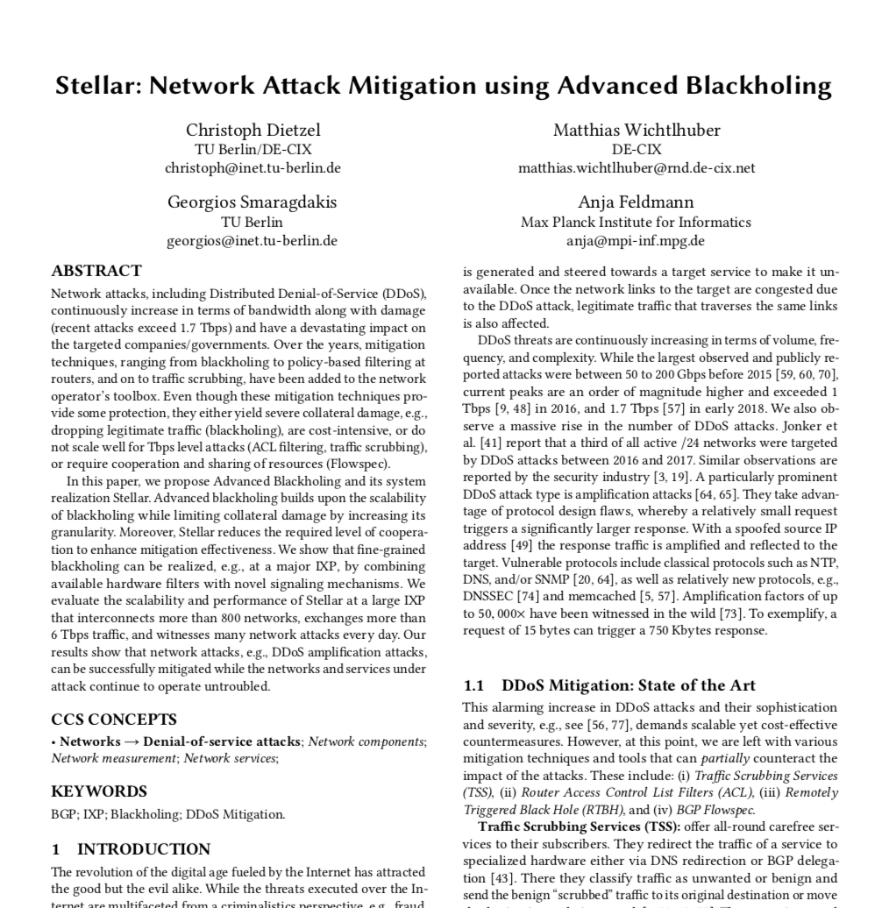


Q & A
christoph.dietzel (at) de-cix.net
@ChrisDicel

Slide 23
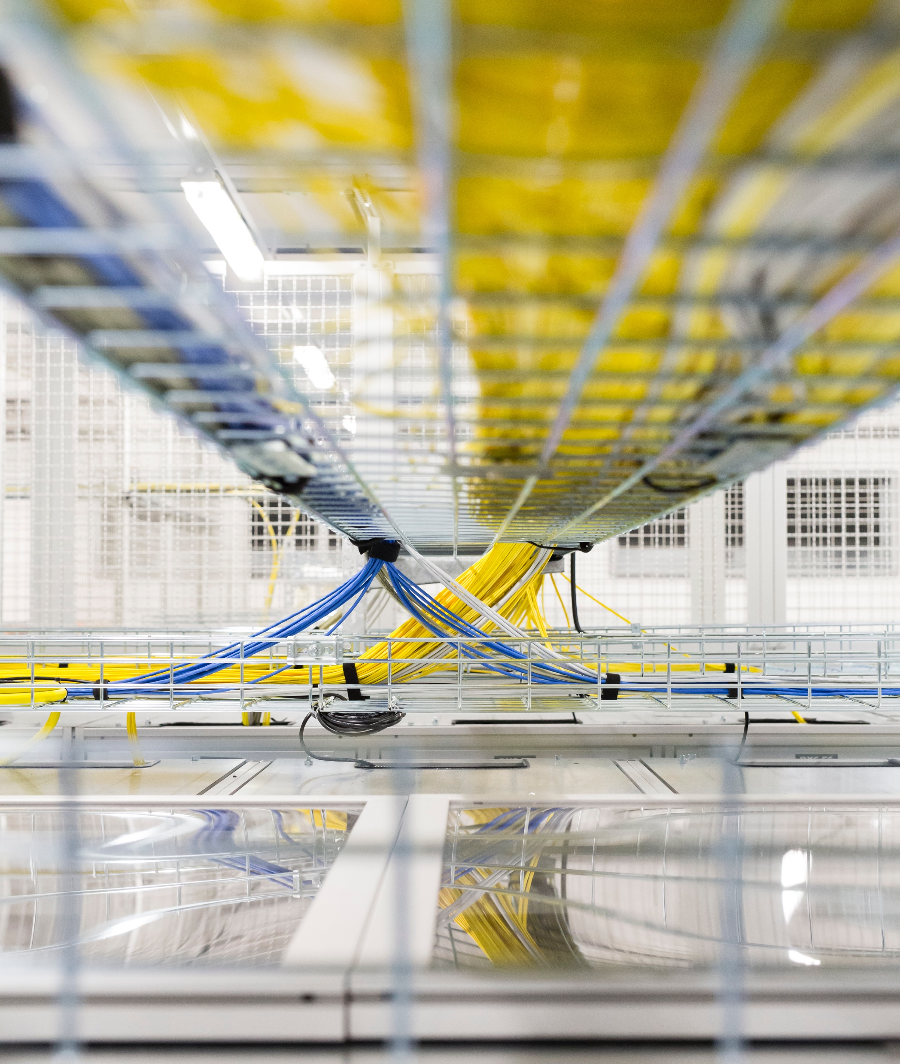
Backup

Slide 24
